Slide 1

Computing 11
Course Orientation
Academic Year 2026–2027
Level Up Through Digital Discoveries 11, 1st edition ©2026
1

Slide 2
Getting to Know Your Course Book
Cambridge Lower Secondary Computing 9
• The course book is the main learning resource for the year.
• It provides the sequence of topics, explanations, activities and opportunities to apply computing skills.
• The book is organized into 6 Units .
2

Slide 3
How We Will Use the Book
Learn
Practise
Create
Review
Read explanations and learn key computing vocabulary.
Complete class activities and apply concepts.
Build programs, models, networks and solutions.
Use the glossary, examples and completed work to revise.
• Teacher slides and demonstrations will support the book—not replace it.
• Your classwork, practical work and assessments will all contribute to your progress.
3

Slide 4
Syllabus Overview
The Grade 11 book is organized into six main units.
1
Systems Architecture Basics
2
Data and Information
3
Data Structures in Python
4
Developing Mobile Applications II
5
Advanced Imaging
6
Advanced Multimedia
4

Slide 5
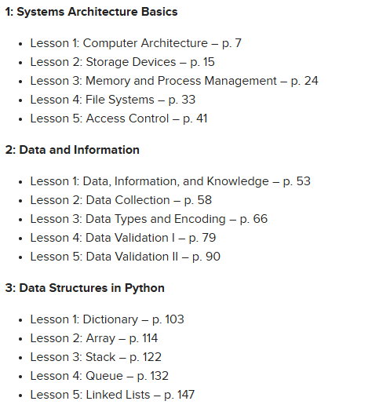
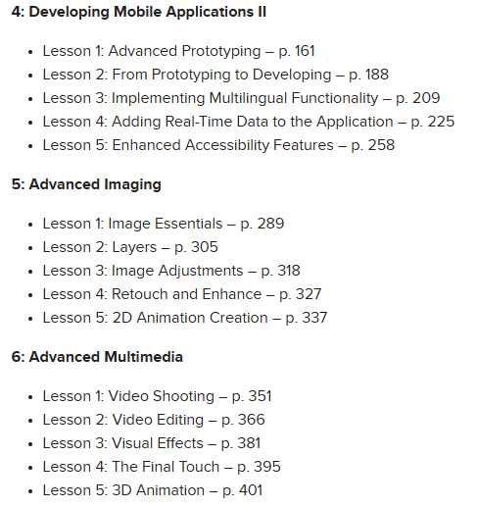
Book Table of Contents
The Grade 11 book is organized into six main units.

Slide 6
Skills You Will Develop
Computer Systems & Architecture
Data & Information
Understand computer components, storage, memory, processes, file systems, and access control
Distinguish between data, information, and knowledge; collect, encode, validate, and interpret data
Python Programming & Data Structures
Mobile Application Development
Write Python programs that store, retrieve, organize, and manipulate data using appropriate structures
Design prototypes, develop applications, add multilingual support, use real-time data, and improve accessibility
Digital Imaging
Multimedia Production
Work with images, layers, adjustments, retouching, enhancement, and 2D animation
Plan, shoot, edit, enhance, and finalize video projects
6

Slide 7
Classroom Rules & Expectations
• Be on time, prepared and ready to learn.
• Listen when instructions or demonstrations are being given.
• Ask questions respectfully and contribute to discussions.
• Complete your own work honestly; give credit when you use someone else's ideas.
• Keep your class clean and organized .
• Use devices only for the task set by the teacher.
7

Slide 8
Computer Lab Rules
• Handle computers, keyboards, mice and other equipment carefully.
• Do not change cables, settings or equipment unless the teacher tells you to.
• Keep food and drinks away from computers.
• Use only your assigned account and keep passwords private.
• Save work in the correct location and log out when instructed.
• Report damaged equipment, suspicious pop-ups or technical problems immediately.
• Leave the workstation tidy before you leave.
8

Slide 9
E-Safety: Stay Safe Online
Protect personal information
Use strong passwords
Do not share passwords, addresses, phone numbers or other private information.
Create passwords that are difficult for others to guess and never share them.
Think before you click
Be respectful
Be careful with links, attachments, downloads and unfamiliar websites.
Communicate politely; do not bully, threaten or embarrass others online.
Check information
Tell a trusted adult
Question suspicious messages and consider whether online information is reliable.
If something online makes you uncomfortable or seems unsafe, report it to a trusted adult.
9

Slide 10
Course Requirements
• Complete classwork activities and practical tasks carefully and on time.
• Complete Weekly Homework on time.
• Prepare for quizzes, practical assessments and other teacher-set assessments.
• If you miss a lesson, find out what was covered and complete the required work.
• Ask for help early when you are stuck.
10

Slide 11
How to Be Successful in Computing
• Be curious — ask “Why?” and “How?”
• Practise — computing skills improve through doing.
• Debug — errors are part of programming and problem solving.
• Collaborate appropriately — share ideas, but complete your own work.
• Review regularly — small amounts of revision are better than last-minute cramming.
• Be responsible — use technology safely, respectfully and purposefully.
The goal: understand technology, not just use it.
11

Slide 12
First-Lesson Orientation Activity
Think
Explore
Set a Goal
What do you already know about computing? Name one topic you feel confident about and one topic you want to improve.
Look through the contents page. Which of the six units sounds most interesting to you? Why?
Choose one learning goal for this year. Example: “I want to become better at testing and debugging my programs.”
12

Slide 13
Welcome to Computing 11!
Learn • Practise • Create • Test • Improve
Be safe. Be respectful. Be curious.
Let’s make this a great year of computing!
14

